Slide 1
Java programming #2 Collections, Strings

Slide 2
String classes in Java
String
StringBuilder
StringBuffer

Slide 3
String
Immutable
Final class (cannot have subclasses)
Thread safe
Methods (manipulating)
Methods (comparing)
Official documentation

Slide 4
StringBuilder
Mutable
Final class (cannot have subclasses)
Thread unsafe
Official documentation

Slide 5
StringBuffer
Mutable
Final class (cannot have subclasses)
Thread safe
Official documentation

Slide 6
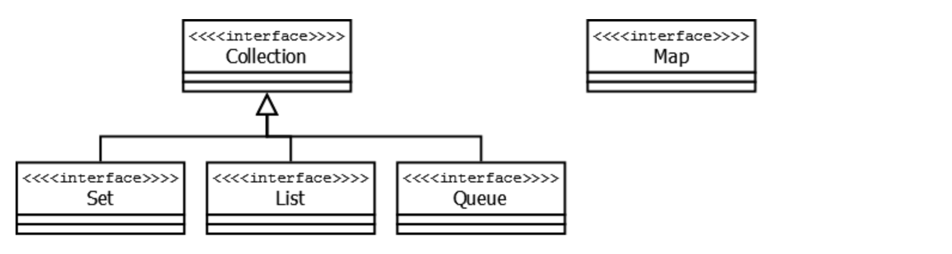
Collections framework overview
Documentation

Slide 7
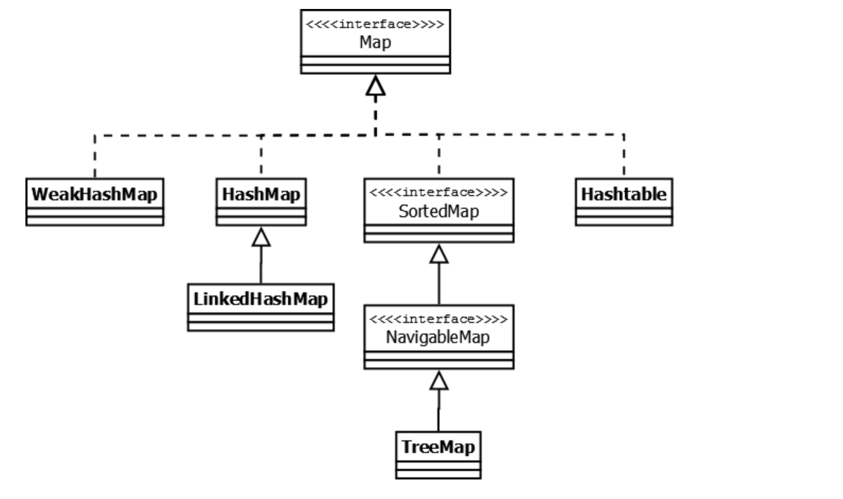
Collections framework overview

Slide 8
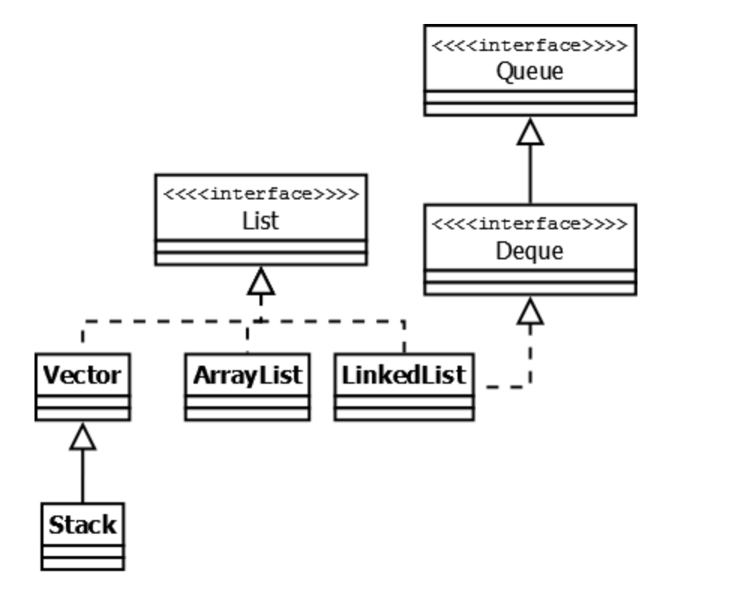
Collections framework overview

Slide 9
Frequently used classes
HashMap
HashSet
ArrayList
LinkedList

Slide 10
ArrayList
Based on continuous memory block
Enables auto resize
Constant random access
Adding an element has constant amortized time cost
Not synchronized
Documentation

Slide 11
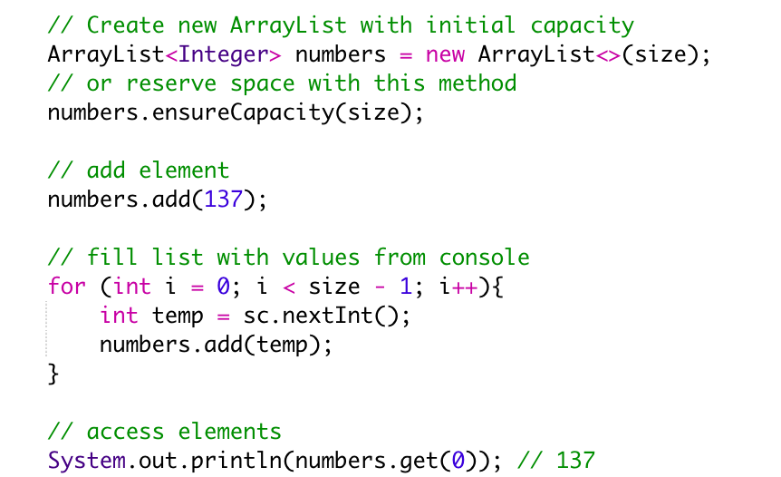
Typical usage of ArrayList

Slide 12
LinkedList
Based on distributed memory blocks
Enables auto resize
Slow random access
Constant add time
Not synchronized
Documentation

Slide 13
HashMap
Stores pairs of (key, value)
Enables auto resize
Amortized constant add, lookup and delete
Not synchronized
Does not guarantee order of elements
Documentation

Slide 14
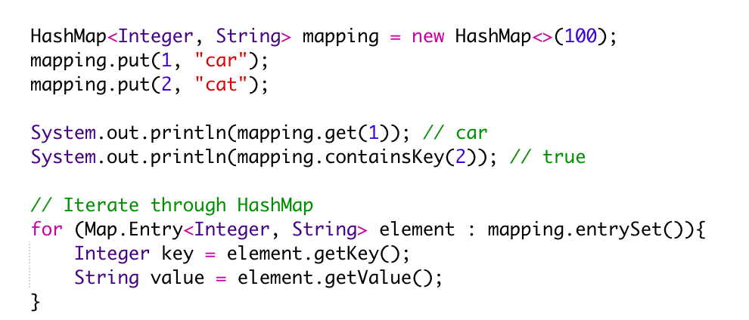
Typical usage of HashMap

